Slide 1
Relational Algebra (Part-12)
20.11

Slide 2
Contents
Join

Slide 3
Join(⋈)
The join operation is one of the essential operation of relational algebra. It is a binary operation that allows the user to combine two relations in a specified way. Means if we want to retrieve attributes or rows from more than one table simultaneously satisfying some conditions then we need join operation.
It can be further subdivided into Theta Join, Inner Join and Natural Join.

Slide 4
Theta Join or condition join

Slide 5
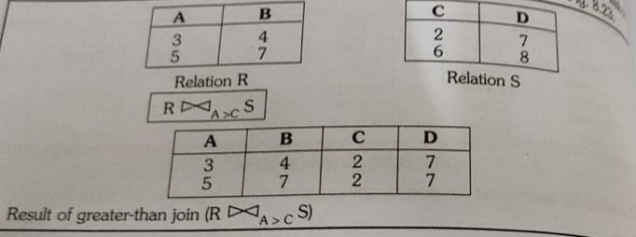
Greater than join

Slide 6
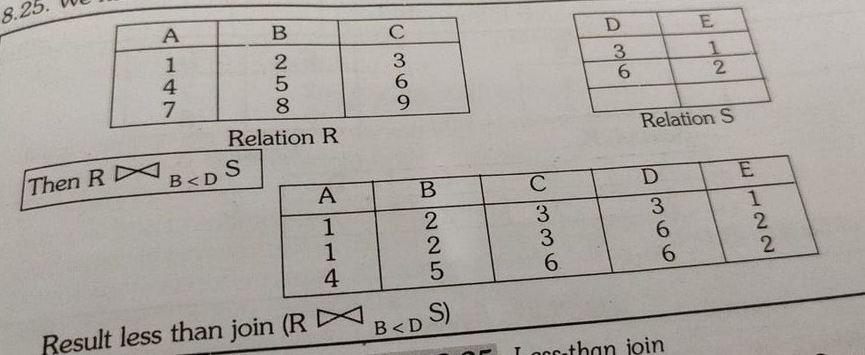
Less than join

Slide 7
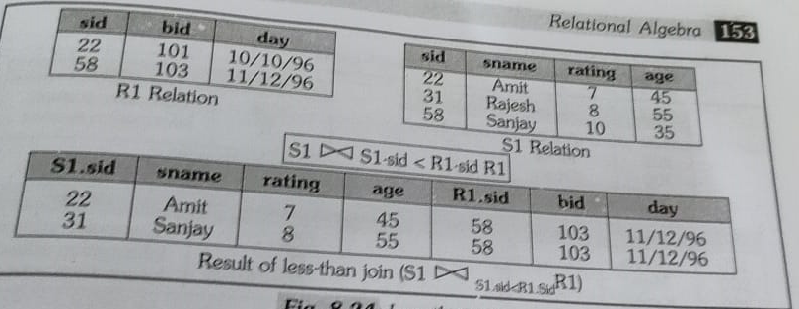
Less than join

Slide 8
Equijoin or inner join
Equijoin is a special case of conditional join where only equality condition holds between a pair of attributes.
Means the equijoin operator is one which the join condition consist of only the equality condition.
The resultant relation of an equijoin operation always has one or more pair of attributes that have identical values in every tuple.

Slide 9
Equijoin or inner join
It is a binary operation.
R1 ⋈ _{<join condition>} R2
Here, the <join condition> is of the form R1.a = R2.b.
σ_{student.sid = subject.sid} (student X subject)
Produces all combinations of tuples from R1 and R2 that satisfy the join condition. This join condition involves attributes from both relations such as follows;
R1.a = R2.b
If R1(A1, A2, …, An) is joined with R2(B1, B2, …, Bn) using the condition R1.A1 = R2.B1, then it produces a new temporary relation R(A1, A2, …, An, B1, B2, …, Bn) and every tuple (record) of R1 is combined with every tuple of R2 where R2.B1 value is same as the R1.A1 value. The result consists of all records that satisfy the join condition.

Slide 10
Equijoin or inner join
Student
SID | Name | Age | Phone
C001 | Ram | 15 | 8652398452
C023 | Amit | 17 | 7894562310
Subject
Student X Subject
SID | Subject
C001 | Physics
C023 | Computer
C023 | OS
Student.sid | Name | Age | Phone | Subject.sid | Subject
C001 | Ram | 15 | 8652398452 | C001 | Physics
C001 | Ram | 15 | 8652398452 | C023 | Computer
C001 | Ram | 15 | 8652398452 | C023 | OS
C023 | Amit | 17 | 7894562310 | C001 | Physics
C023 | Amit | 17 | 7894562310 | C023 | Computer
C023 | Amit | 17 | 7894562310 | C023 | OS
Student ⋈ _{<Student.sid=Subject.sid>} Subject
Student.sid | Name | Age | Phone | Subject.sid | Subject
C001 | Ram | 15 | 8652398452 | C001 | Physics
C023 | Amit | 17 | 7894562310 | C023 | Computer
C023 | Amit | 17 | 7894562310 | C023 | OS

Slide 11
Equijoin or inner join
Student
SID | Name | Age | Phone
C001 | Ram | 15 | 8652398452
C023 | Amit | 17 | 7894562310
Subject
Student X Subject
CID | Subject
C001 | Physics
C023 | Computer
C023 | OS
Sid | Name | Age | Phone | CID | Subject
C001 | Ram | 15 | 8652398452 | C001 | Physics
C001 | Ram | 15 | 8652398452 | C023 | Computer
C001 | Ram | 15 | 8652398452 | C023 | OS
C023 | Amit | 17 | 7894562310 | C001 | Physics
C023 | Amit | 17 | 7894562310 | C023 | Computer
C023 | Amit | 17 | 7894562310 | C023 | OS
Student ⋈ _{<Student.sid=Subject.cid>} Subject
Student.sid | Name | Age | Phone | Subject.sid | Subject
C001 | Ram | 15 | 8652398452 | C001 | Physics
C023 | Amit | 17 | 7894562310 | C023 | Computer
C023 | Amit | 17 | 7894562310 | C023 | OS

Slide 12
Natural Join
It is a binary operation.
R1 ⋈ R2
R1 ⋈ R2 = σ_{<join condition>}(R1 X R2)
Here, the <join condition> is the Equijoin condition that checks for same/similar attributes of R1 and R2.
Same as EQUIJOIN except that the join attributes of R2 are not included in the resulting relation; if the join attributes have the same names, they do not have to be specified at all.
If R1(A, B, C) is joined with R2(A, D, E), then it produces a new temporary relation R(A, B, C, D, E). The result consists of all records that satisfy the join condition. Also, observe that R does not include A twice.
Natural join is just like equi-join. Only difference is that the common attribute is not included in the result twice in natural join unlike equi-join.

Slide 13
Natural Join
Student
SID | Name | Age | Phone
C001 | Ram | 15 | 8652398452
C023 | Amit | 17 | 7894562310
Subject
Student X Subject
SID | Subject
C001 | Physics
C023 | Computer
C023 | OS
Student.sid | Name | Age | Phone | Subject.sid | Subject
C001 | Ram | 15 | 8652398452 | C001 | Physics
C001 | Ram | 15 | 8652398452 | C023 | Computer
C001 | Ram | 15 | 8652398452 | C023 | OS
C023 | Amit | 17 | 7894562310 | C001 | Physics
C023 | Amit | 17 | 7894562310 | C023 | Computer
C023 | Amit | 17 | 7894562310 | C023 | OS
Student ⋈ Subject
Sid | Name | Age | Phone | Subject
C001 | Ram | 15 | 8652398452 | Physics
C023 | Amit | 17 | 7894562310 | Computer
C023 | Amit | 17 | 7894562310 | OS

Slide 14


